Slide 1
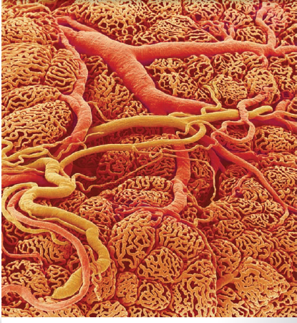
The Endocrine system
Steroids and Thyroid Hormone
Endocrine Disorders
Al-Farabi Kazakh National University
Higher School of Medicine

Slide 2
LEARNING OUTCOMES
As a result of the lesson you will be able to:
a. explain some general causes and examples of hormone
hyposecretion and hypersecretion;
b. briefly describe some common disorders of pituitary,
thyroid, parathyroid, and adrenal function; and
c. in more detail, describe the causes and pathology of diabetes mellitus.
d. Why do corticosteroids and thyroid hormones require
transport proteins to travel in the bloodstream?
e. Explain how MIT, DIT, T3, and T4 relate to each other
structurally.
f. Where are hormone receptors located in target cells?
Name one hormone that employs each receptor location.
g. Explain how one hormone molecule can activate millions
of enzyme molecules.
Al-Farabi Kazakh National University
Higher School of Medicine

Slide 3
LEARNING OUTCOMES
As a result of the lesson you will be able to:
a. Explain hormone receptors and therapy
b. Describe Steroids and Thyroid Hormone;
c. Explain steroids and thyroid hormone;
d. Describe peptides and catecholamines;
e. Signal Amplification
f. Modulation of Target-Cell Sensitivity.
Al-Farabi Kazakh National University
Higher School of Medicine

Slide 4
Hormone Receptors and Therapy
In treating endocrine disorders, it is essential to understand the role of hormone receptors. For example, a defect or deficiency of insulin receptors causes type 2 diabetes mellitus.
Androgen insensitivity syndrome is due to an androgen receptor defect or deficiency; it causes genetic males to develop feminine genitalia and other features.
Estrogen stimulates the growth of some malignant tumors with estrogen receptors. For this reason, estrogen replacement
therapy should not be used for women with estrogen-dependent cancer.
Al-Farabi Kazakh National University
Higher School of Medicine

Slide 5
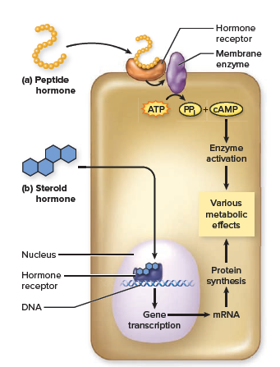
Steroids and Thyroid Hormone
Some hormones enter the target-cell nucleus and act directly on the genes, changing target-cell physiology by either activating or inhibiting transcription of the gene for a metabolic enzyme or other protein. Such is the case with steroid hormones.
Being hydrophobic, they diffuse easily through the phospholipid regions of the plasma membrane.
Al-Farabi Kazakh National University
Higher School of Medicine

Slide 6
Steroids and Thyroid Hormone
Thyroid hormone also acts on nuclear receptors. It enters the target cell by means of an ATP-dependent transport protein.
Surprisingly, although 90% of the TH secreted by the thyroid gland is thyroxine (T4), T4 has little metabolic effect.
Within the target-cell cytoplasm, an enzyme removes one iodine and converts it to the active form, T3. This T3, as well as a smaller amount of T3 produced directly by the thyroid and absorbed from the blood, enters the nucleus and binds to receptors in the chromatin.
Al-Farabi Kazakh National University
Higher School of Medicine

Slide 7
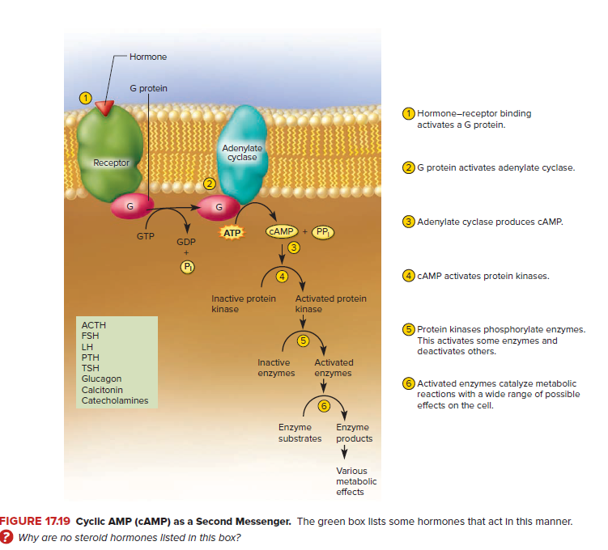
Peptides and Catecholamines
Al-Farabi Kazakh National University
Higher School of Medicine

Slide 8
Peptides and Catecholamines
Peptides and catecholamines are hydrophilic and cannot penetrate a target cell, so they must stimulate its physiology indirectly.
They bind to cell-surface receptors, which are linked to second- messenger systems on the other side of the plasma membrane. The best-known second messenger is cyclic adenosine monophosphate.
When glucagon binds to the surface of a liver cell, for example, its receptor activates a G protein, which in turn activates adenylate cyclase, the membrane enzyme that produces cAMP. cAMP leads ultimately to the activation of enzymes that hydrolyze glycogen stored in the cell. Somatostatin, by contrast, inhibits cAMP synthesis.
Al-Farabi Kazakh National University
Higher School of Medicine

Slide 9
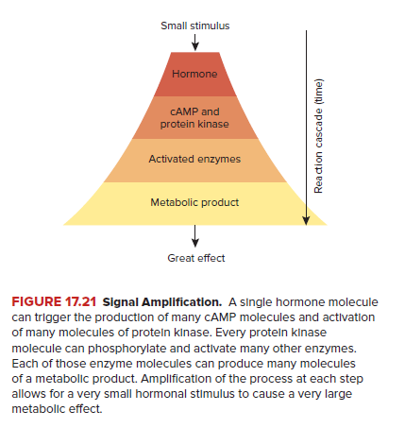
Peptides and Catecholamines
Al-Farabi Kazakh National University
Higher School of Medicine

Slide 10
Signal Amplification
Hormones are extraordinarily potent chemicals.
Through a mechanism called signal amplification (or a cascade effect), one hormone molecule triggers the synthesis of not just one enzyme molecule but an enormous number.
To put it in a simplistic but illustrative way, suppose 1 glucagon molecule triggered the formation of 1,000 molecules of cAMP, cAMP activated a protein kinase, each protein kinase activated 1,000 other enzyme molecules, and each of those produced 1,000 molecules of a reaction product.
These are modest numbers as chemical reactions go, and yet even at this low estimate, each glucagon molecule would trigger the production of 1 billion molecules of reaction product.
Whatever the actual numbers may be, you can see how signal amplification enables a very small stimulus to produce a very large
effect.
Al-Farabi Kazakh National University
Higher School of Medicine

Slide 11
Modulation of Target-Cell Sensitivity
Target cells can adjust their sensitivity to a hormone by changing the number of receptors for it. In up-regulation, a cell increases the number of hormone receptors and becomes more sensitive to the hormone.
In late pregnancy, for example, the uterus produces oxytocin receptors, preparing itself for the surge of oxytocin that will occur during childbirth.
Down-regulation is the process in which a cell reduces its receptor population and thus becomes less sensitive to a hormone.
Al-Farabi Kazakh National University
Higher School of Medicine

Slide 12
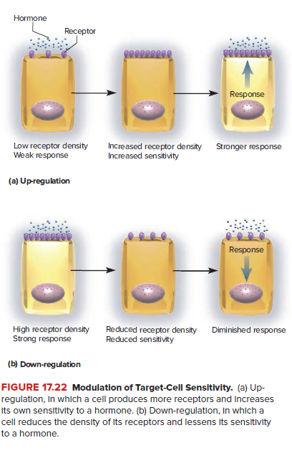
Modulation of Target-Cell Sensitivity
Al-Farabi Kazakh National University
Higher School of Medicine

Slide 13
Modulation of Target-Cell Sensitivity
Permissive effects, in which one hormone enhances the target organ’s response to a second hormone to come later. For example, when estrogen from the ovaries enters the cells of the uterine mucosa, it binds to its nuclear receptors and activates the gene for a protein that functions as the progesterone receptor. The uterine cells then up-regulate their nuclear progesterone receptors.
Antagonistic effects, in which one hormone opposes the action of another. For example, insulin lowers blood glucose level and glucagon raises it. During pregnancy, estrogen from the placenta inhibits the mammary glands from responding to prolactin; thus milk is not secreted until the placenta is shed at birth.
Al-Farabi Kazakh National University
Higher School of Medicine

Slide 14
Hormone Clearance
The rate of hormone removal is called the metabolic clearance rate (MCR), and the length of time required to clear 50% of the hormone from the blood is the half-life.
The faster the metabolic clearance rate MCR, the shorter is the half-life. Growth hormone, for example, uses no transport protein and has a half-life of only 6 to 20 minutes. Thyroxine, by contrast, is protected by transport proteins and maintains a physiologically effective level in the blood for up to 2 weeks after its secretion ceases.
Al-Farabi Kazakh National University
Higher School of Medicine

Slide 15
Antagonistic Effects of Insulin and Glucagon on the Liver.
Antagonistic Effects of Insulin and Glucagon on the Liver. (a) Insulin promotes the uptake of blood glucose by cells and its polymerization to make glycogen, an energy-storage carbohydrate. In doing so, it lowers the blood sugar level. (b) Glucagon stimulates some cells, especially in the liver, to break down glycogen and release glucose to the bloodstream, thereby raising blood sugar level. Glycogenesis is the synthesis of glycogen; glycogenolysis is its hydrolysis (breakdown to glucose); and gluconeogenesis is the synthesis of glucose from noncarbohydrates, especially fats and proteins.
Al-Farabi Kazakh National University
Higher School of Medicine

Slide 16
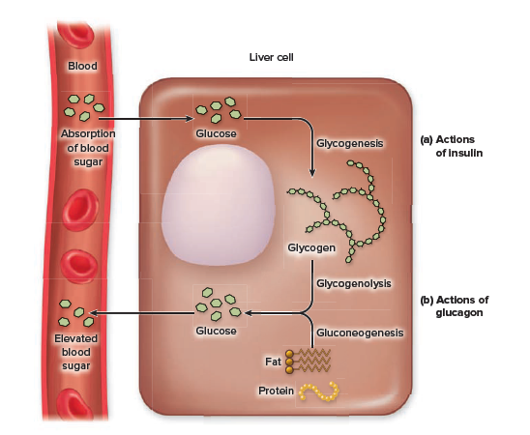
Antagonistic Effects of Insulin and Glucagon on the Liver.
Al-Farabi Kazakh National University
Higher School of Medicine

Slide 17
Questionnaires
Answer the following questions to test your understanding of
the preceding section:
1. What are the three chemical classes of hormones? Name
at least one hormone in each class.
2. Why do corticosteroids and thyroid hormones require
transport proteins to travel in the bloodstream?
3. Explain how MIT, DIT, T3, and T4 relate to each other
structurally.
4. Where are hormone receptors located in target cells?
Name one hormone that employs each receptor location.
5. Explain how one hormone molecule can activate millions
of enzyme molecules.
Al-Farabi Kazakh National University
Higher School of Medicine

Slide 18
Endocrine Disorders
Expected Learning Outcomes
When you have completed this section, you should be able to
a. explain some general causes and examples of hormone
hyposecretion and hypersecretion;
b. briefly describe some common disorders of pituitary,
thyroid, parathyroid, and adrenal function; and
c. in more detail, describe the causes and pathology of
diabetes mellitus.
Al-Farabi Kazakh National University
Higher School of Medicine

Slide 19
Excessive cortisol secretion
Excessive cortisol secretion (or medical use of hydrocortisone)
can, however, have some adverse effects. Cortisol suppresses the
secretion of sex hormones such as estrogen, testosterone, and luteinizing
hormone, causing disturbances of fertility and sexual function.
Long-term elevation of cortisol secretion also compromises
one’s immunity.
It inhibits the synthesis of protective leukotrienes and prostaglandins (discussed shortly), suppresses antibody production, and kills immature T and B cells— two important families of immune cells.
Wounds heal poorly, and a person under chronic stress is more susceptible to infections and some forms of cancer. Stress can aggravate peptic ulcers because of reduced resistance to the bacteria that cause them and because
circulating epinephrine reduces secretion of the gastric mucus and
pancreatic bicarbonate that normally protect the stomach lining.
Al-Farabi Kazakh National University
Higher School of Medicine

Slide 20
Hyposecretion and Hypersecretion
Inadequate hormone release is called hyposecretion. It can
result from tumors or lesions that destroy an endocrine gland or
interfere with its ability to receive signals from another cell. For
example, a fractured sphenoid bone can sever the hypothalamo–
hypophyseal tract and prevent the transport of oxytocin and
antidiuretic hormone (ADH) to the posterior pituitary. The
resulting ADH hyposecretion disables the water-conserving
capability of the kidneys and leads to diabetes insipidus, an
output of abundant but glucose-free urine. (Insipidus means
“without taste” and refers to the lack of sweetness of the urine, in
contrast to the sugary urine of diabetes mellitus.)
Al-Farabi Kazakh National University
Higher School of Medicine

Slide 21
Excessive hormone release, called hypersecretion, has multiple
causes. Some tumors result in the overgrowth of functional
endocrine tissue. A pheochromocytoma (FEE-o-CRO-mo-sy-
TOE-muh), for example, is a tumor of the adrenal medulla that
secretes excessive amounts of epinephrine and norepinephrine.
Some tumors in nonendocrine organs produce hormones. For example,
some lung tumors secrete ACTH and overstimulate cortisol
secretion by the adrenal gland. Whereas certain autoimmune
disorders can cause endocrine hyposecretion, others cause hypersecretion.
An example of this is toxic goiter (Graves29 disease),
in which autoantibodies mimic the effect of TSH on the thyroid,
activating the TSH receptor and causing thyroid hypersecretion.
Endocrine hypersecretion disorders can also be mimicked by excess
or long-term clinical administration of hormones such as
Cortisol.
Al-Farabi Kazakh National University
Higher School of Medicine

Slide 22
Pituitary Disorders
The hypersecretion of growth hormone (GH) in childhood or
adolescence, before the epiphyseal plates (growth zones) of the
long bones are depleted, causes gigantism, whereas childhood
hyposecretion causes pituitary dwarfism.
Now that growth hormone is plentiful, made by genetically engineered bacteria containing the human GH gene, pituitary dwarfism has become rare. In adulthood, after the epiphyseal plates have closed, GH hyposecretion causes little if any problem, but hypersecretion causes acromegaly—thickening of the bones and soft tissues, with especially noticeable effects on the hands, feet, and face.
Al-Farabi Kazakh National University
Higher School of Medicine

Slide 23
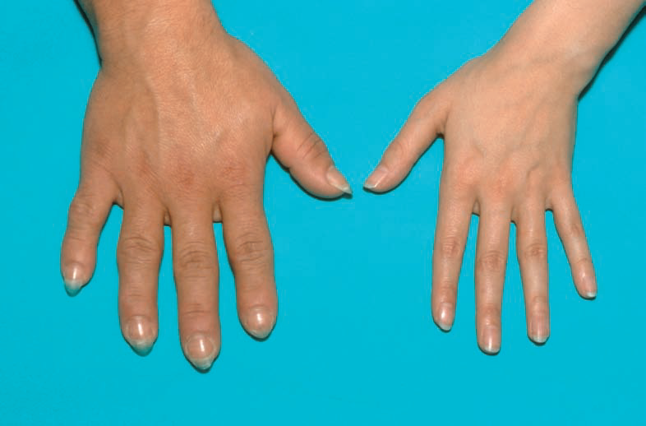
Acromegaly
Acromegaly, a
Condition Caused by Growth Hormone
Hypersecretion in Adulthood.
The left
photo exemplifies characteristic thickening of
the hands compared to the normal hand on
the right.
Al-Farabi Kazakh National University
Higher School of Medicine

Slide 24
Thyroid and Parathyroid Disorders
Congenital hypothyroidism is thyroid hyposecretion present
from birth. Severe or prolonged adult hypothyroidism can cause myxedema (MIX-eh-DEE-muh). Both syndromes are described in table 17.8, and both can be treated with oral thyroid hormone.
A more conspicuous, often striking abnormality of the thyroid is endemic goiter.
It results from a deficiency of dietary iodine. Without iodine, the gland cannot synthesize TH.
Without TH, the pituitary gland receives no feedback and acts as
if the thyroid were understimulated. As if trying to stimulate it
more strongly, the pituitary secretes extra TSH, which makes the
thyroid produce more and more colloid (thyroglobulin).
Al-Farabi Kazakh National University
Higher School of Medicine

Slide 25
Thyroid and Parathyroid Disorders
The parathyroids, because of their location and small size, are
sometimes accidentally removed in thyroid surgery or degenerate
when neck surgeries cut off their blood supply. Without hormone
replacement therapy, the resulting hypoparathyroidism causes a
rapid decline in blood calcium level; in as little as 2 or 3 days, this
can lead to a fatal, suffocating spasm of the muscles of the larynx
(hypocalcemic tetany).
Hyperparathyroidism, excess PTH secretion, is usually caused by a parathyroid tumor. It causes the bones to become soft, deformed, and fragile; it raises the blood levels of calcium and phosphate ions; and it promotes the formation of renal calculi (kidney stones) composed of calcium phosphate.
Section 7.4 further describes the relationship among parathyroid
function, blood calcium, and bone tissue.
Al-Farabi Kazakh National University
Higher School of Medicine

Slide 26
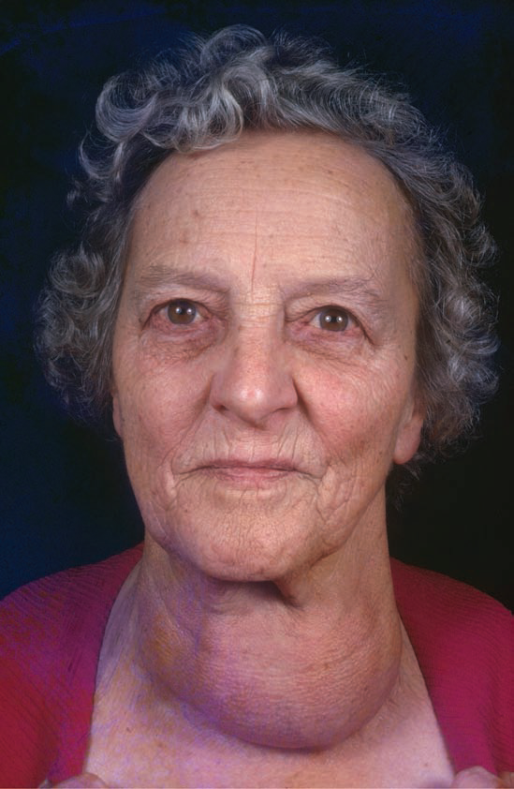
Endemic Goiter.
Endemic Goiter. An iodine deficiency in this person’s diet resulted in a lack of thyroid hormone and a large
goiter. For lack of negative feedback inhibition, the pituitary secreted elevated levels of thyroid-stimulating hormone (TSH).
This resulted in hypertrophy of the thyroid gland.
Al-Farabi Kazakh National University
Higher School of Medicine

Slide 27
Adrenal Disorders
Cushing syndrome is excess cortisol secretion owing to any of several causes: ACTH adrenocorticotropic hormone hypersecretion by the pituitary, ACTH secreting tumors, or hyperactivity of the adrenal cortex independently of ACTH adrenocorticotropic hormone.
Cushing syndrome disrupts carbohydrate and
protein metabolism, leading to hyperglycemia, hypertension, muscular weakness, and edema. Muscle and bone mass are lost rapidly as protein is catabolized. Some patients exhibit abnormal fat deposition between the shoulders (“buffalo hump”) or in the face (“moon face”) (fig. 17.27). Long-term hydrocortisone therapy can have similar effects.
Al-Farabi Kazakh National University
Higher School of Medicine

Slide 28
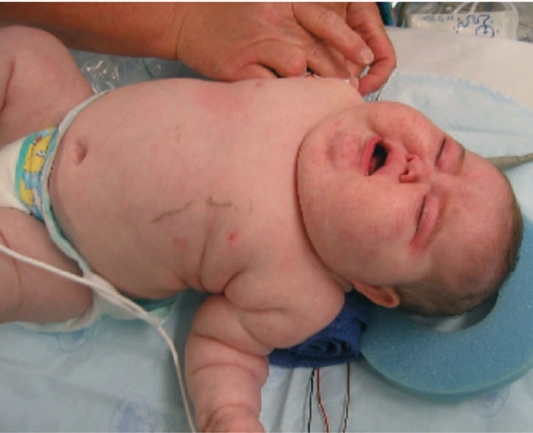
Cushing Syndrome
Cushing Syndrome in an
Infant. Note the “moon face” appearance
characteristic of this syndrome.
Al-Farabi Kazakh National University
Higher School of Medicine

Slide 29
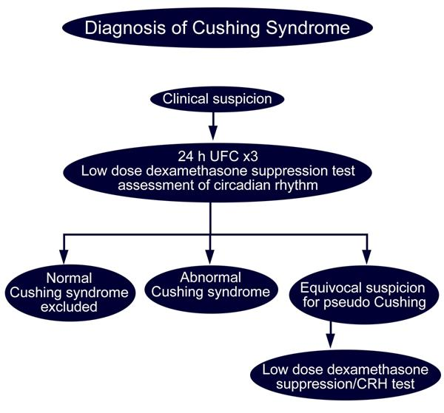
Al-Farabi Kazakh National University
Higher School of Medicine

Slide 30
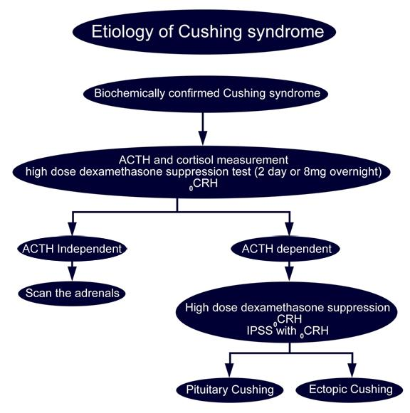
Al-Farabi Kazakh National University
Higher School of Medicine

Slide 31
Adrenogenital syndrome (AGS),
Adrenogenital syndrome (AGS), the hypersecretion of adrenal
androgens, commonly accompanies Cushing syndrome. In
children, AGS often causes enlargement of the penis or clitoris
and the premature onset of puberty.
Prenatal AGS can result in newborn girls exhibiting masculinized genitalia and being misidentified as boys (fig. 17.28). In women, AGS produces such masculinizing effects as increased body hair, deepening of the voice, and beard growth.
Al-Farabi Kazakh National University
Higher School of Medicine

Slide 32
Diabetes Mellitus
Diabetes mellitus can be defined as a disruption of
carbohydrate, fat, and protein metabolism resulting from the hyposecretion or inaction of insulin. The classic signs and symptoms with which patients often first present to a physician are “the three polys”: polyuria (excessive urine output), polydipsia (intense thirst), and polyphagia(ravenous hunger).
Al-Farabi Kazakh National University
Higher School of Medicine

Slide 33
Diabetes Mellitus
Blood and urine tests can confirm a diagnosis of DM by revealing
three further signs: hyperglycemia (elevated blood glucose),
glycosuria (glucose in the urine), and ketonuria (ketones in the
urine). DM was originally named for the sweetness of the urine
stemming from glycosuria. Before the advent of chemical tests
for glucose, physicians tasted their patients’ urine as part of their
diagnostic process.
Why glycosuria and polyuria occur? Answer please
Al-Farabi Kazakh National University
Higher School of Medicine

Slide 34
Why glycosuria and polyuria occur?
The kidneys filter blood
plasma and convert the filtrate to urine. In a healthy person, the
kidney tubules remove all glucose from the filtrate and return it to
the blood, so there is little or no glucose in the urine. Water follows
the glucose and other solutes by osmosis, so the tubules also
reclaim most of the water in the filtrate.
The excess passes through into the urine. Glucose and ketones in
the tubules also raise the osmolarity of the tubular fluid and cause
osmotic diuresis—water remains in the tubules with these solutes,
so large amounts of water are passed in the urine. This accounts
for the polyuria, dehydration, and thirst of diabetes.
Al-Farabi Kazakh National University
Higher School of Medicine

Slide 35
Types and Treatment
There are two forms of diabetes mellitus: type 1 and type 2. These were formerly called juvenile-onset or insulin-dependent DM, and adult-onset or non-insulin-dependent DM, respectively.
Type 1 diabetes mellitus accounts for 5% to 10% of cases in
the United States. What causes it? It begins with heredity. Several
genes have been identified that predispose a person to type 1 DM.
Al-Farabi Kazakh National University
Higher School of Medicine

Slide 36
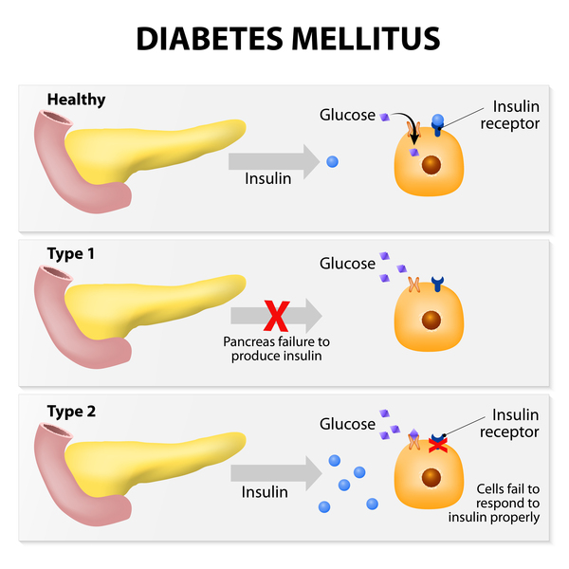
Diabetes Mellitus
Al-Farabi Kazakh National University
Higher School of Medicine

Slide 37
Type 1 diabetes mellitus
Then, when a genetically susceptible individual is infected by certain viruses (rubella, cytomegalovirus, or a few others), the body produces autoantibodies that destroy pancreatic beta cells. To a great extent, this destruction is tolerated and produces no disease, but when 80% to 90% of the beta cells are gone, insulin falls to such a critically low level that it can no longer regulate glycemia, the blood glucose level.
Now comes the problematic hyperglycemia
and all of its insidious complications.
Al-Farabi Kazakh National University
Higher School of Medicine

Slide 38
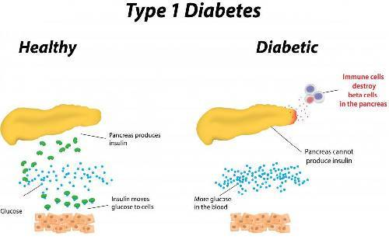
Al-Farabi Kazakh National University
Higher School of Medicine

Slide 39
Type 2 diabetes mellitus
Some 90% to 95% of diabetics, however, have type 2
DM. Here, the chief problem is not lack of insulin, but insulin
resistance—unresponsiveness of the target cells to the hormone.
The level of insulin may actually be very high in the early stage of
the disease, although it later tends to fall to normal or subnormal
levels. Again, heredity is one of the causes, although no one gene,
or even a mere few, can be blamed for the disease; more than
36 genes are known, so far, to contribute to the risk of type 2 DM.
Al-Farabi Kazakh National University
Higher School of Medicine

Slide 40
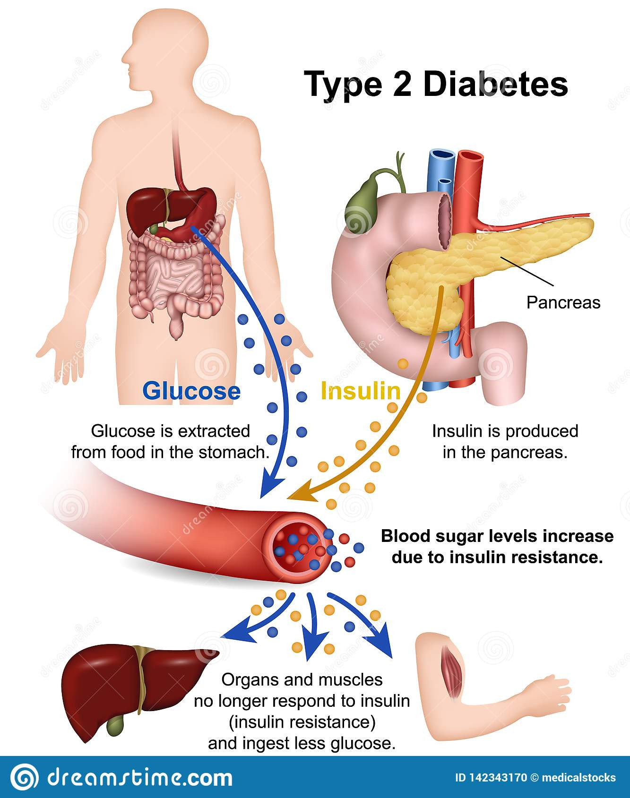
Al-Farabi Kazakh National University
Higher School of Medicine

Slide 41
Diabetes Mellitus type 2
Other important risk factors are age, obesity, and a sedentary lifestyle. All of these are accompanied by the progressive replacement of muscular tissue with fat.
Muscle plays a highly important role in absorbing blood glucose and buffering glycemia, so as muscle mass diminishes, a person becomes less and less able to regulate glycemia.
Type 2 DM develops slowly and is usually diagnosed after
age 40, but it is becoming increasingly prevalent in young people
because of early obesity.
Al-Farabi Kazakh National University
Higher School of Medicine

Slide 42
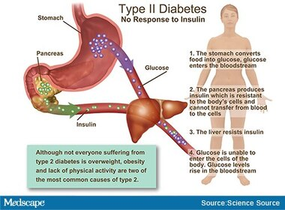
Al-Farabi Kazakh National University
Higher School of Medicine

Slide 43
Pathogenesis
When cells cannot absorb glucose, they must get their energy someplace else; they metabolize fat and protein. In time, this leads to muscular atrophy, emaciation, and weakness. Before insulin therapy was introduced in 1922, the victims of type 1 DM wasted away to an astonishing extent.
Al-Farabi Kazakh National University
Higher School of Medicine

Slide 44
Diabetes Pathogenesis
Diabetes was described in the first century as “a melting down of the
flesh and limbs into urine.” Adult patients weighed as little as 27
to 34 kg (60–75 lb) and looked like victims of severe famine. Their
breath had a disagreeable sweet ketone smell, like rotten apples.
One typical patient was described by medical historian Michael
Bliss as “barely able to lift his head from his pillow, crying most
of the time from pain, hunger, and despair.” In the terminal stage,
patients became increasingly drowsy, gasped for air, became comatose,
and died within a few hours.
Most diabetic children livedless than 1 year after diagnosis—a year of utmost misery at that. Such was the natural course of the disease in the centuries before
insulin therapy.
Al-Farabi Kazakh National University
Higher School of Medicine

Slide 45
Ketonuria
Ketonuria promotes osmotic diuresis, flushes Na+ and K+ from the body, and creates electrolyte
deficiencies that can lead to abdominal pain, vomiting, irregular
heartbeat, and neurological dysfunction. As acids, ketones lower
the pH of the blood and produce a condition called ketoacidosis.
This causes a deep, gasping breathing called Kussmaul 37 respiration, typical of terminal diabetes. It also depresses the nervous system and produces diabetic coma.
Al-Farabi Kazakh National University
Higher School of Medicine

Slide 46
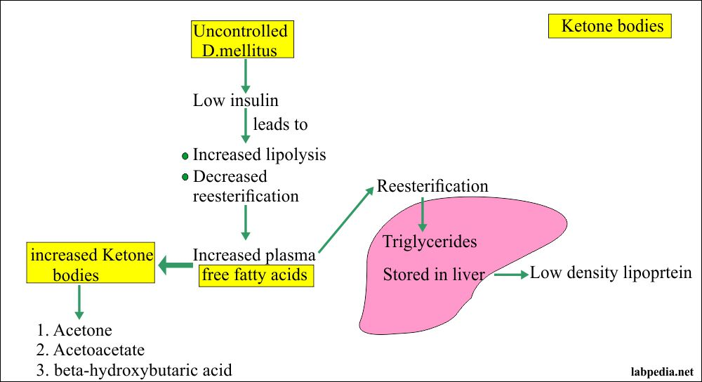
Ketonuria
Al-Farabi Kazakh National University
Higher School of Medicine

Slide 47
Two of the common complications
Two of the common complications of longterm DM are blindness and renal failure, brought on by arterial degeneration in the retinas and kidneys.
Death from kidney failure is much more common in type 1 DM than in type 2.
In type 2, the most common cause of death is heart failure stemming from coronary artery disease.
Al-Farabi Kazakh National University
Higher School of Medicine

Slide 48
Diabetic neuropathy
Another complication is diabetic neuropathy—nerve damage
resulting from impoverished blood flow. This can lead to erectile
dysfunction, incontinence, and loss of sensation from affected
areas of the body.
Microvascular disease in the skin results in poor healing of skin wounds, so even a minor break easily becomes ulcerated,
infected, and gangrenous.
This is especially common in the feet, because people take less notice of foot injuries; circulation is poorer in the feet (farthest from the heart) than anywhere else; pressure on the feet makes them especially susceptible to tissue injury; and neuropathy may make a person unaware of skin lesions or reluctant to consent to amputation of toes, or more, from which
they feel no pain.
Al-Farabi Kazakh National University
Higher School of Medicine

Slide 49
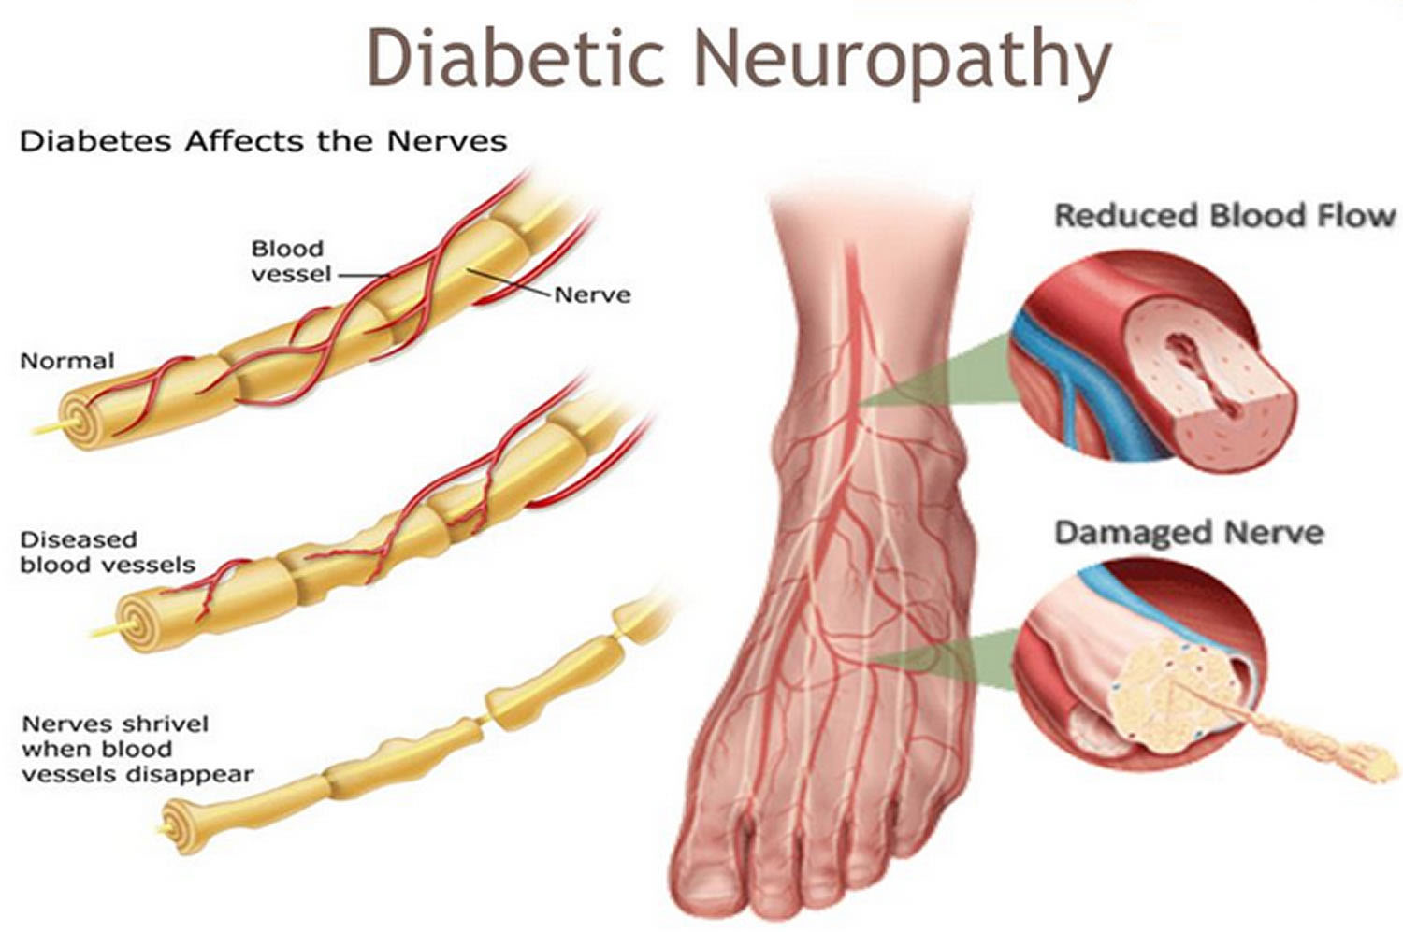
Al-Farabi Kazakh National University
Higher School of Medicine

Slide 50
Answer the following questions to test your understanding of the preceding section:
1. Explain some causes of hormone hyposecretion, and give
examples. Do the same for hypersecretion.
2. Why does a lack of dietary iodine lead to TSH hypersecretion?
Why does the thyroid gland enlarge in endemic
goiter?
3. In diabetes mellitus, explain the chain of events that lead
to (a) osmotic diuresis, (b) ketoacidosis and coma, and
(c) gangrene of the lower limbs.
Al-Farabi Kazakh National University
Higher School of Medicine

